Slide 1
House Sale Prices Dataset Analysis Result
Abner Misigina
Data Analytics Flex Student
June 2021

Slide 2
Outline
Introduction
Data
Methods
Analysis Results
Recommendations
Notes:
The Analysis Results includes the Descriptive, Correlation, Hypothesis and Inferential statistics results.

Slide 3
Introduction
House Sales Prices can be determined various factors:
Lot Area
Neighborhoods
Year Built and Remodeled
Building Types and House Styles
Above Grade Living Area
Garage area and capacity
House Over All Condition
Availability of amenities and utilities
Notes:
This dataset is about House Sales. Everyone has a plan of buying their own dream homes. They have a lot of criteria. This dataset shows most of these criteria/factors associated with house sale prices. These include:

Slide 4
Data
The data is taken from Kaggle.com
The dataset includes:
1460 houses
81 variables
Sold from 2006 to 2010
Located in Ames, Iowa

Slide 5
Methods
Used MS Excel
Pivot table analysis
Tables and Charts
Data analysis ToolPac
Conducted t-test analysis
Significance taken at p-value < 0.05
Calculated 95% Confidence Intervals
Prepared visualizations

Slide 6
Analysis Results
Descriptive statistics analysis results
Correlation analysis results
Hypothesis and
Inferential statistics analysis results
Notes:
Overview

Slide 7
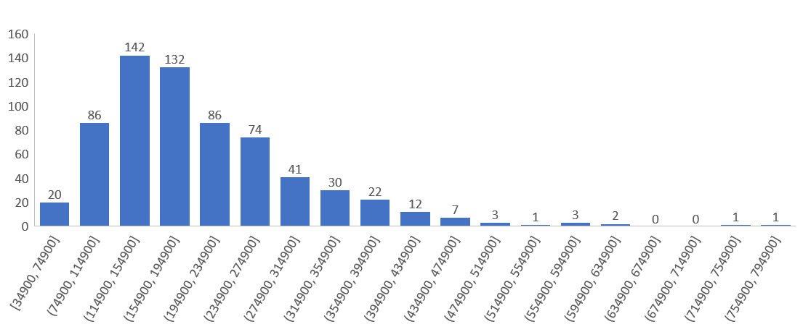
Distribution of House Sale Prices (Average House Sale Price = $180,921)*
Notes:
The distribution is skewed to the right. But based on Central Limit Theorem, with larger sample size (>30 or preferably >60), the distribution of sample means will be approximately normal. Therefore, we can use this assumption to go forward in our analysis.

Slide 8
Houses Year Built

Slide 9
Total Rooms Above Grade

Slide 10
House Garage Cars #

Slide 11
Correlation Analysis Result
Using MS Excel, Data Analysis ToolBox
Selected quantitative independent variables
Got Correlation Coefficient results
Sale Price | SalePrice
Lot Area | 0.263843354
Overall Condition | -0.07785589
Year Built | 0.522897333
Year Remodeled | 0.507100967
Grade Living Area | 0.708624478
Total Rooms Above Grade | 0.533723156
Garage Cars | 0.640409197
Garage Area | 0.623431439

Slide 12
Hypothesis & Inferential Statistics Analysis Result 1
Year Built
Ho: The population means of House Sale Prices of those houses built 1985-2010 AND before 1985 ARE NOT DIFFERENT (μ1 - μ2 = 0)
Ha: ARE DIFFERENT (μ1 - μ2 ≠ 0)
t-test result
t-statistic > t-critical value
P value < 0.05
=> Reject null hypothesis

Slide 13
Hypothesis & Inferential Statistics Analysis Result 2
Total Rooms Above Grade
Ho: The population means of House Sale Prices of those houses with Total Rooms Above Grade of 7 or more AND 6 or less ARE NOT DIFFERENT (μ1 - μ2 = 0)
Ha: ARE DIFFERENT (μ1 - μ2 ≠ 0)
t-test result
t-statistic > t-critical value
P value < 0.05
=> Reject null hypothesis

Slide 14
Hypothesis & Inferential Statistics Analysis Result 3
Garage Cars #
Ho: The population means of House Sale Prices of those houses with Garage capacity of 2 or more AND just 1 ARE NOT DIFFERENT (μ1 - μ2 = 0)
Ha: ARE DIFFERENT (μ1 - μ2 ≠ 0)
t-test result
t-statistic > t-critical value
P value < 0.05
=> Reject null hypothesis

Slide 15
Recommendations
Based on the Hypothesis testing and Inferential Statistics Analysis result, these houses have higher average sale price:
Lately built houses (1985-2010)
Houses with more Above Grade Rooms (7 or more)
Houses with more Garage capacity (2 or more)
More data analysis in the area
Comparison to other places

Slide 16
Thank you
Q&A

